Slide 1
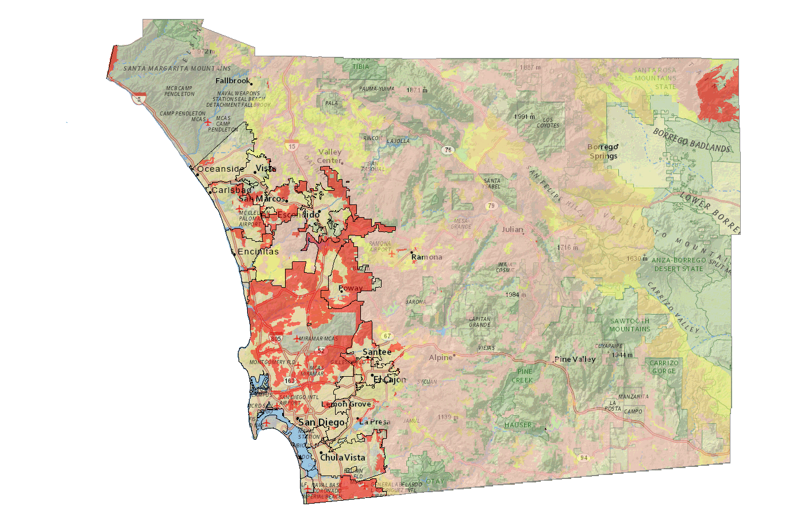
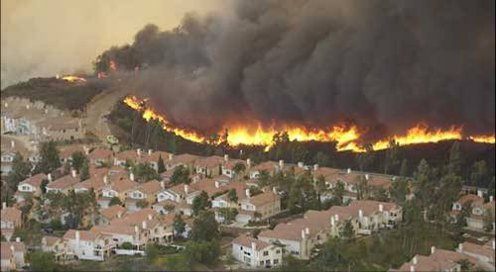
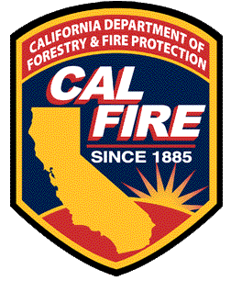
Fire Hazard Severity Zones
CAL FIRE

Slide 2
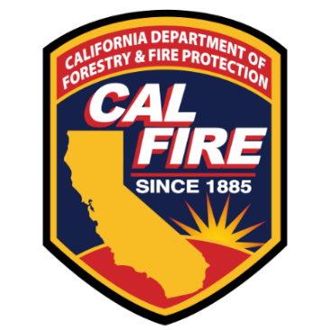
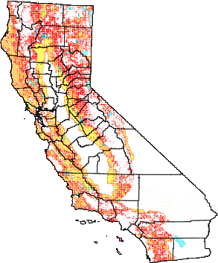
Fire Hazard Severity Zone Remap
Fire Hazard Severity Zones
What are the Zones?
The maps are required by
Government Code 51178 & 51179
Identify levels of fire hazard
• 3 levels (Moderate, High, & Very High)

Slide 3
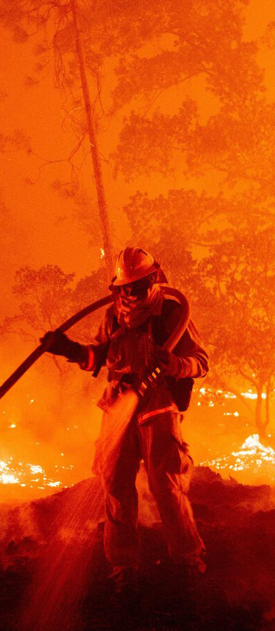
Fire Hazard Severity Zone Remap
Fire Hazard Severity Zones
How are the Zones determined?
CAL FIRE used the best available science and data to develop, and field test a model that served as the basis of zone assignments. The model evaluated the probability of the area burning and potential fire behavior in the area.
Factors: fire history, vegetation, flame length, blowing embers, proximity to wildland, terrain, and weather

Slide 4
New Updates
Fire Hazard Severity Zones
New Updates
Updated burn probabilities for wildland areas (inclusive of 2020 fires)
Updated fire environment footprints (urban/developed)
Updated Vegetation density for urban areas
Inclusion of slope in the urban zoning model
Localized fire weather used in both wildland and urban models
New firebrand production and transport model using discrete local wind vector distributions

Slide 5
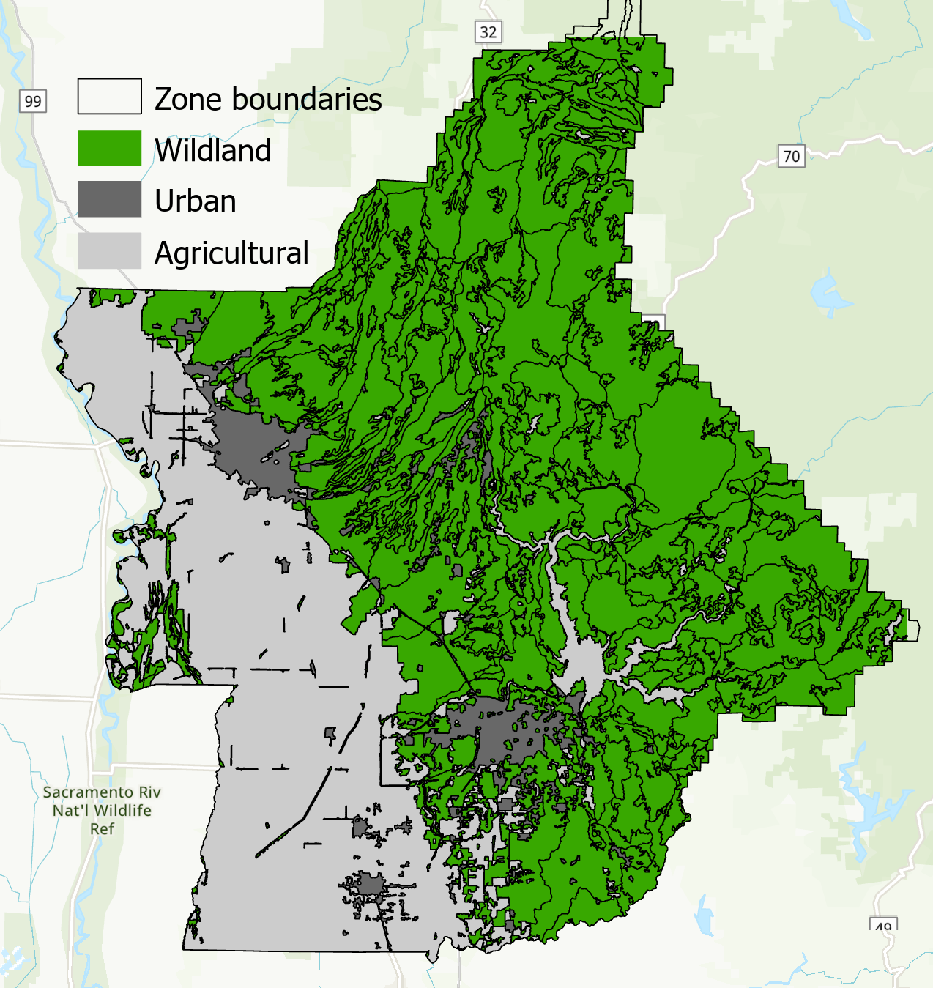
Fire Hazard Severity Zone Remap
Fire Hazard Severity Zones
Wildland vs. Non-wildland Zones
Zones are areas with relatively homogeneous slope and vegetation
Hazard map is produced at 30 m resolution
Scores are averaged within a zone
Wildland is scored independently of urban and agricultural
Urban zones scored using additional model steps

Slide 6
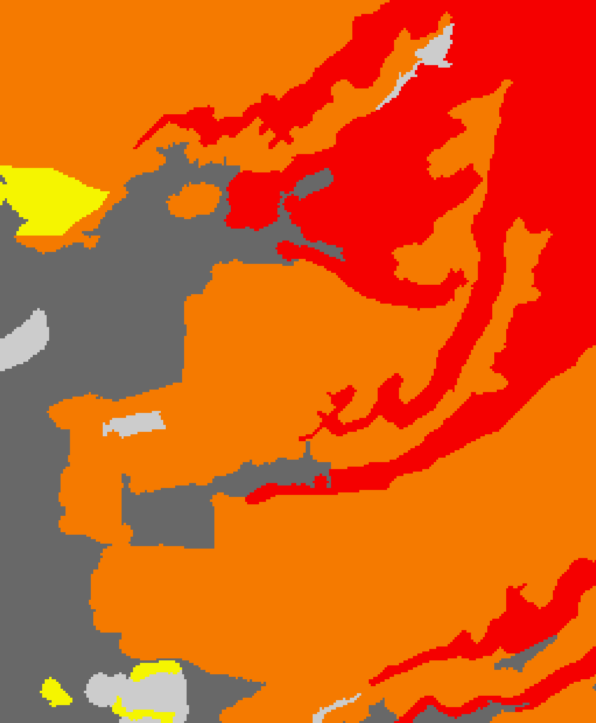
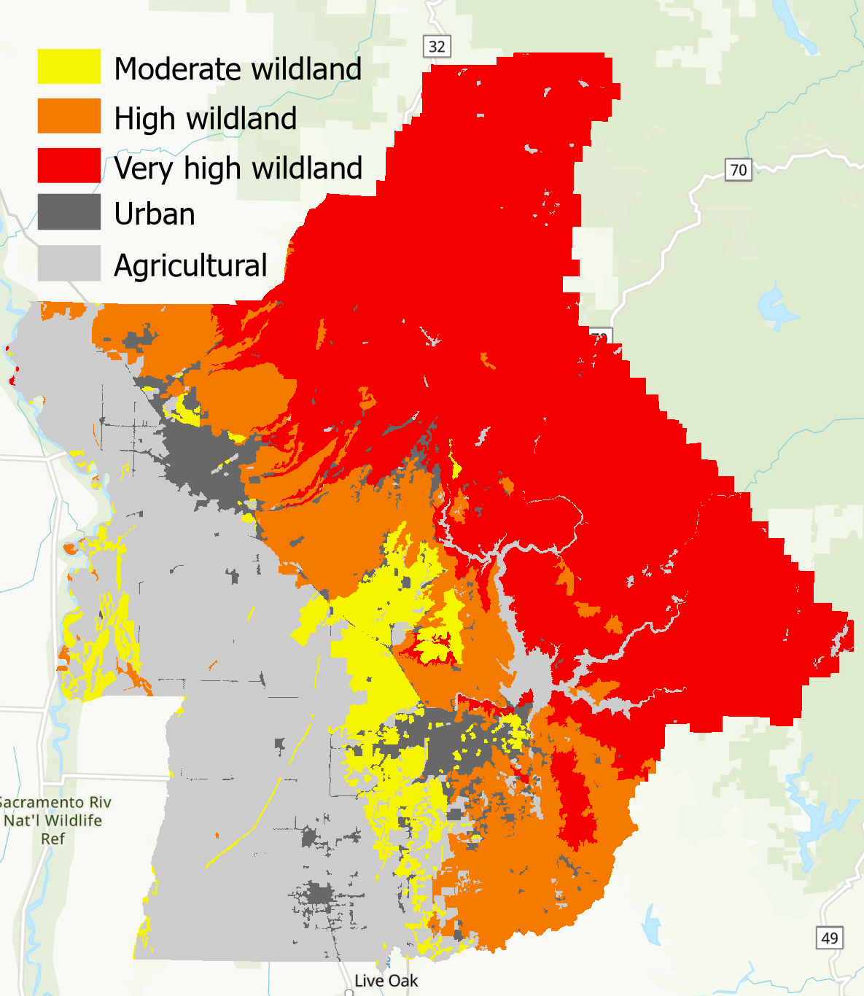
Fire Hazard Severity Zone Remap
Fire Hazard Severity Zones
Wildland FHSZ
Minimum size of 200 acres
Burn probability
Based on fire occurrence from 1991-2020
Fire intensity
Vegetation type
Slope
Local fire weather – how hot/dry/windy are the worst conditions at a given location (based on 2 km data from 2003-2018)

Slide 7
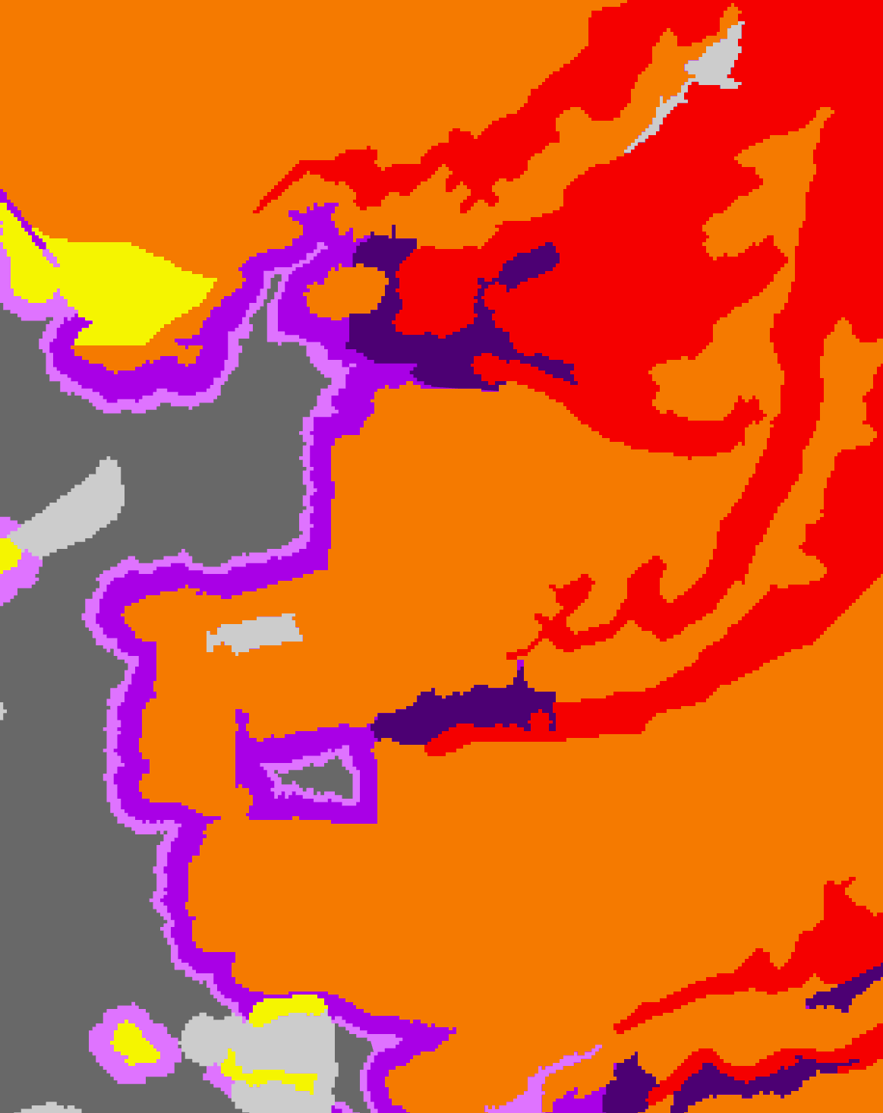
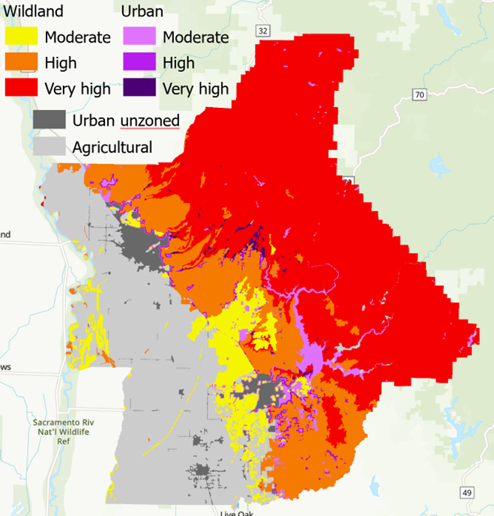
Fire Hazard Severity Zone Remap
Fire Hazard Severity Zones
Urban FHSZ
Minimum size of 20 acres for isolated islands of vegetation embedded in non-wildland.
Based on distance to wildland and hazard level of adjacent wildland
Ember production based on vegetation type and fire weather
Ember transport based on wind speed/direction observed under the most extreme fire weather at a given location
Width of moderate, high and very high bands in urban are based on ember load, urban tree cover and slope

Slide 8
Fire Hazard Severity Zone Remap
Fire Hazard Severity Zones
What is the map for?
Building standards for new construction in the Wildland-Urban Interface (California Building Code Chapter 7A)
Property development standards such as road widths, water supply and signage (Fire Safe Regulations)
Defensible Space Requirements (Government Code 51182)
Natural hazard real estate disclosure

Slide 9
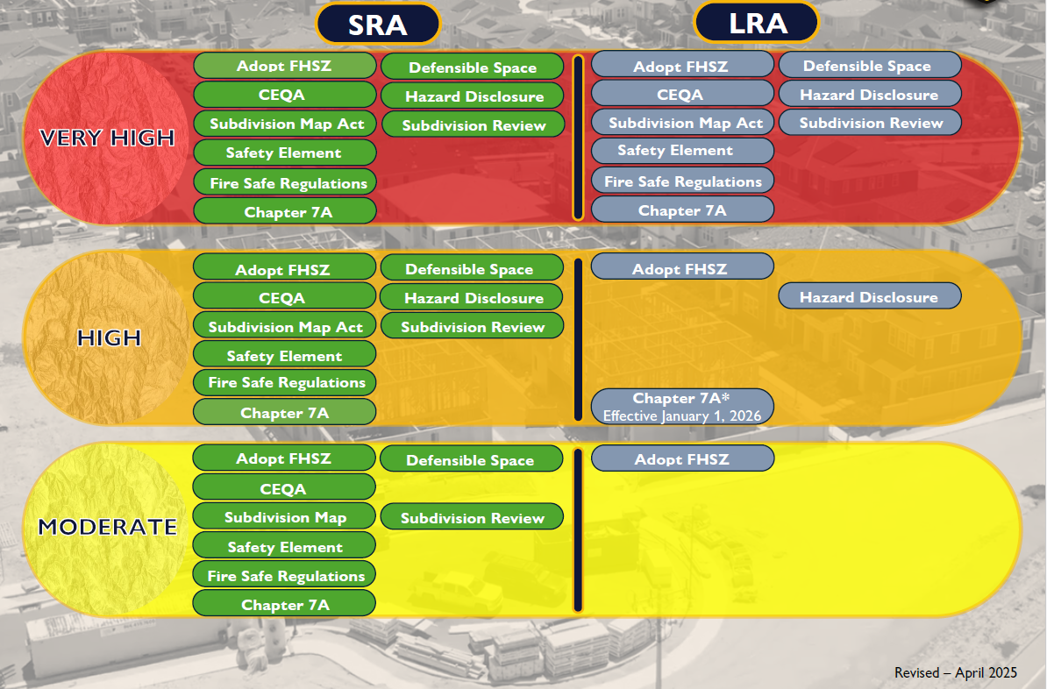
New Updates
Examples of State Minimum Requirements
What’s
Impacted…

Slide 10
Fire Hazard Severity Zone Remap
Fire Hazard Severity Zones
Adoption Timeline:
Notes:
***ADD YOUR SPECIFIC ADOPTION TIMELINE***

Slide 11
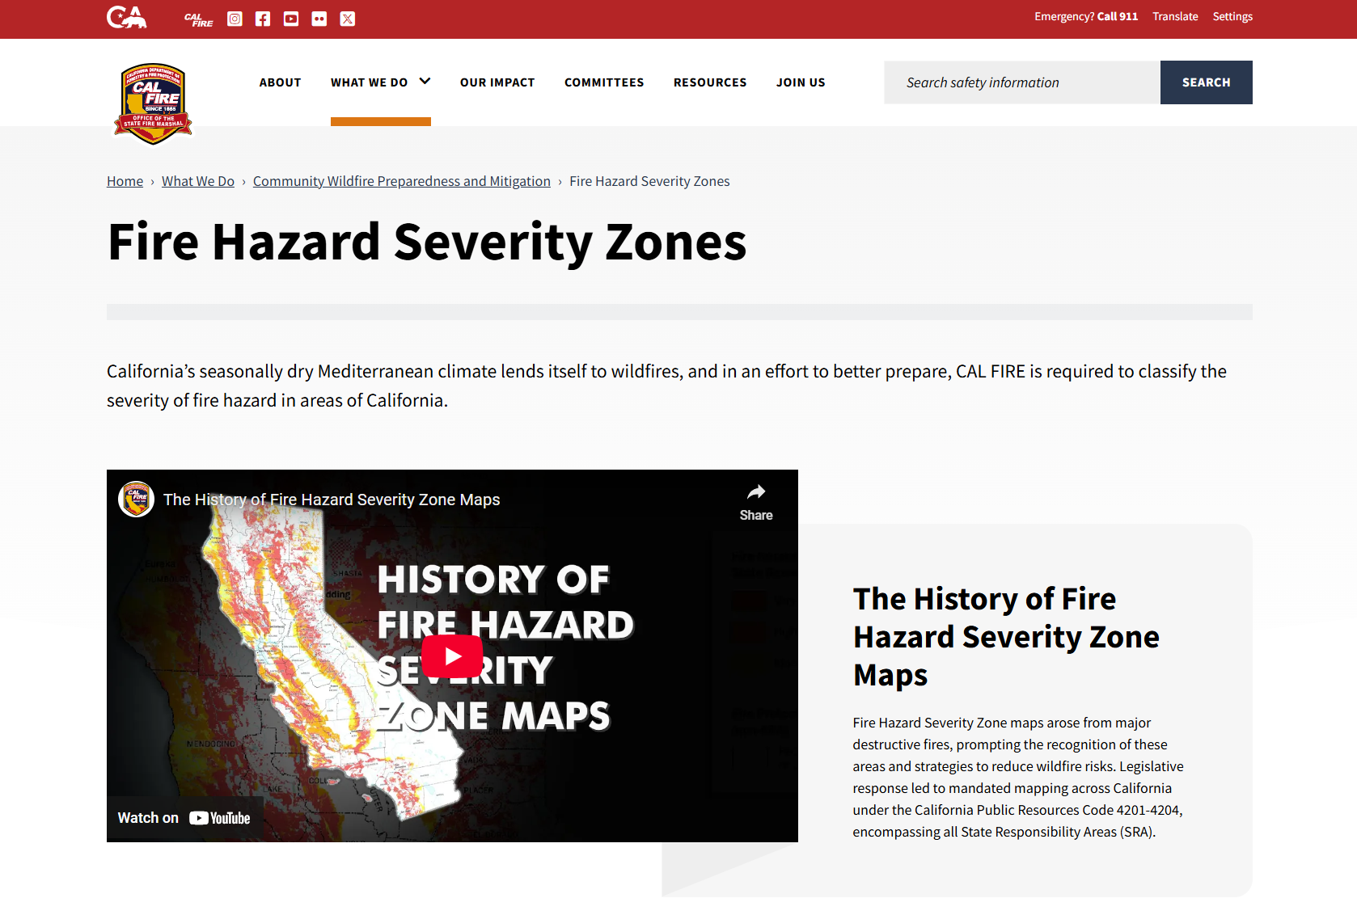
Questions?
osfm.fire.ca.gov/fhsz

